Slide 1
THE EM-ALGORITHM AND GAUSSIAN MIXTURE MODELS
MUHAMMAD FURRUKH ASIF & SHARIM SOHAIL

Slide 2
MOTIVATION FOR THE EM-ALGORITHM
Imagine dealing with an estimation problem that involves a data set with latent variables.
Can we use the MLE to estimate parameters of interest for such a problem?

Slide 3
MOTIVATION FOR THE EM-ALGORITHM
Not Really! Why?
MLE creates the most likely model by looking at the data first, it assumes complete-data likelihood.
So in the presence of latent or unobserved variables the MLE struggles to create an accurate model.
How do we estimate parameters in such a case then?

Slide 4
MOTIVATION FOR THE EM-ALGORITHM
The Expectation-Maximization (EM) Algorithm helps us deal with incomplete-data likelihood.
The EM makes a guess of the parameters first, considering missing data points, and modifies the model to fit the data.

Slide 5
GENERAL FRAMEWORK
The EM algorithm has two main steps:
E-Step: Calculates probabilities of different values of the unobserved data based on our initial parameter guess. It also calculates the log likelihood of each probable value of the unobserved data.
M-Step: Calculates the value of our parameter that gives us the maximum expected log-likelihood under the probable values of the unobserved data.
The two steps are then used iteratively until the algorithm can make no more improvements.
Ascent Property: After every iteration the algorithm never decreases in likelihood.

Slide 6
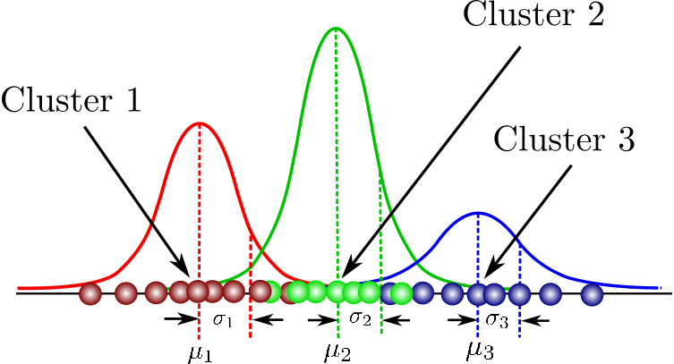
GAUSSIAN MIXTURE MODELS
A Gaussian mixture model is a probabilistic model that assumes all the data points are generated from a mixture of a finite number of Gaussian distributions with unknown parameters

Slide 7
GAUSSIAN MIXTURE MODELS
What if we are interested in knowing which data point belongs to which sub-population?
Here is where the EM Algorithm can help with its soft-clustering super powers!

Slide 8
Our Study
In order to test the EM algorithms ability to soft-cluster Gaussian Mixture Models, here is what we did:
We downloaded a data set of body heights, categorized by gender.
Why did we use this data?
It was readily available
Heights approximately follow a normal distribution.
We calculated gender specific mean and standard deviation for body height to compare with the estimates we get from the algorithm.
We dropped the data points on gender such that we only have uncategorized data for height.
We then utilized the EM algorithm to estimate parameters for female and male heights.

Slide 9
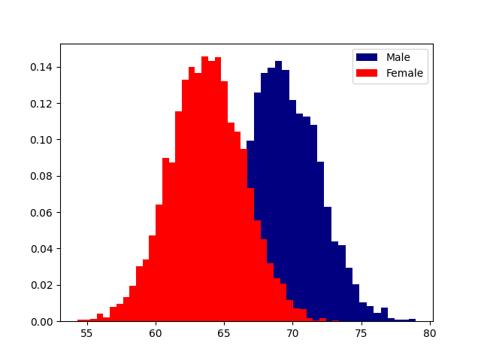
Original Data

Slide 10
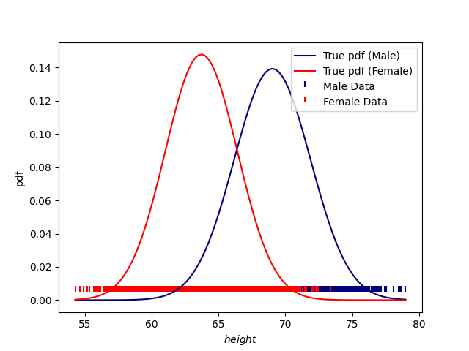
Original Data

Slide 11
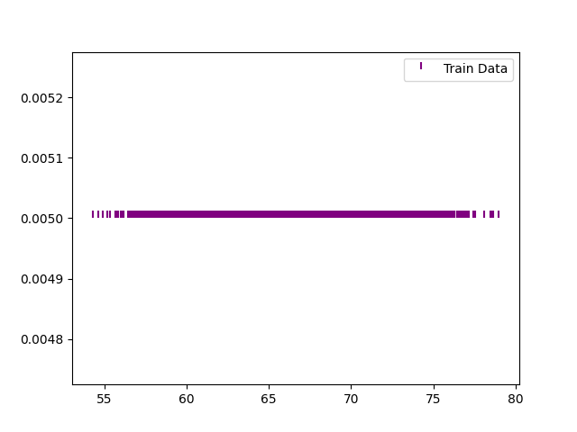
Incomplete Data

Slide 12




E-Step:
First we calculate the likelihood for each datapoint. This is done by calculating the pdf of the data for each cluster (k=1,2) using the estimated values.
Using Bayes Theorem, we calculate the conditional probability of the data belonging to the kth cluster.
where is the initial weight representing the probability of a datapoint belonging to the kth Gaussian. For our study, we assumed equal initial weights ( ).

Slide 13



M-Step
In the maximization step, we re-estimate the parameters as follows:
The algorithm runs iteratively until the results converge.

Slide 14

Graphical Representation

Slide 15
Results
Following are the numerical results from our study:
 | Mean | Variance
Actual-Female | 63.708774 | 7.269947
Actual-Male | 69.026346 | 8.198842
EM-Female | 63.11523311 | 6.25956044
EM-Male | 68.42958853 | 9.25968127
Notes:
[67.116259 62.80619937]
[0.87433392 0.45724108]

Slide 16
Limitations of the EM Algorithm (Jank 2005)
One of the major limitations of the EM Algorithm is that it can be computationally expensive for larger datasets.
To overcome this problem we can use a subset of the dataset to run the EM iterations.
However, it is important to maintain the accuracy of results as we increase the computational efficiency.
To this end, we can use the Ascent-EM algorithm. This algorithm is centered around EM's likelihood-ascent property and only increases the sample when no further improvements are possible based on the current sample.

Slide 17
Citations
Navidi, William. “A Graphical Illustration of the EM Algorithm.” Taylor amp; Francis, www.tandfonline.com/doi/abs/10.1080/00031305.1997.10473582.
Dempster, A.P., et al. Maximum Likelihood from Incomplete Data via the EM Algorithm. rss.onlinelibrary.wiley.com/doi/epdf/10.1111/j.2517-6161.1977.tb01600.x.
The EM Algorithm for Gaussian Mixtures. www.ics.uci.edu/ smyth/courses/cs274/notes/EMnotes.pdf
Jank, Wolfgang. “The Next Wave in Computing, Optimization, and Decision Technologies (2005)”” pg. 202-212
Suhasini, Suba. https://www.stat.tamu.edu/~suhasini/teaching613/chapter7.pdf

